Slide 1
Computer Arithmetic

Slide 2
Arithmetic Processor
Arithmetic instruction in digital computers manipulate data to produce results necessary for the solution of the computational problems.
An arithmetic processor is the part of a processor unit that execute arithmetic instruction
An arithmetic instruction may specify binary or decimal data, and it may be represented in, Fixed point (integer or fraction) OR floating point form.
The designer must be thoroughly familiar with sequence of steps in order to carry out the operation and achieve a correct result.

Slide 3
Algorithm:
  The solution to any problem that is stated by a finite number of well defined procedural step is called algorithm.
Flowchart:
  The convenient method for presenting algorithm is a flowchart.
  The computational steps are specified in rectangular boxes
  Decision steps indicated inside diamond-shaped boxes from which two or more alternate path emerge

Slide 4
Addition and Subtraction
Data types considered for the arithmetic operations are,
  Fixed-point binary data in signed magnitude representation
  Fixed-point binary data in signed-2’s compliment representation
  Floating point binary data
  Binary –coded decimal (BCD) data
Negative fixed point binary number can be represented in three ways,
  Signed magnitude (most computers use for floating point operations )
  Signed 1’s compliment
  Signed 2’s compliment(most computer use for integers)

Slide 5
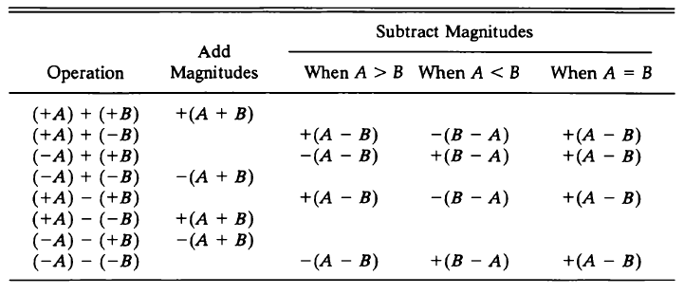
Addition and Subtraction with Signed-Magnitude Data
Eight different conditions to consider for addition and subtraction
Fig : (Addition and subtraction for signed magnitude numbers)

Slide 6
Addition(Subtraction) algorithm:
  When the signs of A and B are identical(different), add the two magnitudes and attach the sign of A to the result.
  When the sign of A and B are different(identical), compare the magnitudes and subtract the smaller number from the larger.
  Choose the sign of the result to be same as A if A > B or the compliment of the sign of A if A < B.
  For equal magnitude subtract B from A and make the sign of the result

Slide 7
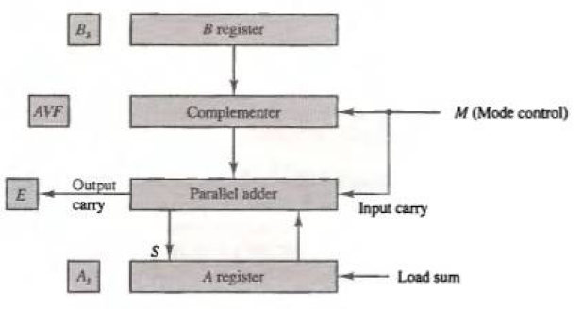
Hardware Implementation
A and B be two registers that hold the magnitudes of No
As and Bs be two flip-flops that hold the corresponding signs
The Result is transferred into A and As.

Slide 8
Cont..
Parallel adder is needed to perform the micro operation A + B.
Parallel subtractor are needed to perform A – B or B – A.
  Can be accomplished by means of compliment and add
Comparator circuit is needed to establish if A > B, A = B or A < B
  Comparison can be determine from the end carry after the subtraction
The sign relationship can be determine from an exclusive-OR gate with As and Bs as inputs
Output carry are transferred to E flip-flop
  Where it can be checked to determine the relative magnitude of the Nos.
Add overflow flip-flop (AVF) holds the overflow bit when A and B are added.

Slide 9
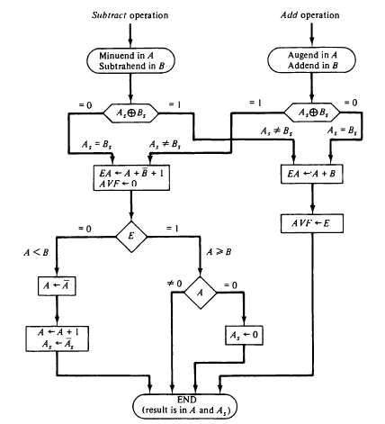
Hardware Algorithm

Slide 10
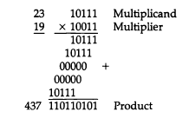
Multiplication Algorithm
Multiplication of two fixed point binary numbers in signed magnitude representation is done by the process of successive shift and add operations.
Numerical Example:
The process consist of looking at successive bits of the multiplier, least significant bit first.
If the multiplier bit is 1, multiplicand is copied down otherwise zeros are copied down
Copied number in successive line shifted one position to the left from the previous number. Finally, the numbers are added and their sum forms the product.

Slide 11
Hardware Implementation
Multiplication process is change slightly.
First, instead of providing registers to store and add simultaneously as many binary numbers as there are bits in multiplier,
  It is convenient to provide an adder for the summation of two number
  And successively accumulate the partial products in a register
Second, instead of shifting the multiplicand to the left, the partial product is shifted right
  Which result in leaving the partial product and the multiplicand in the required relative position
Third, when the corresponding bit of the multiplier is 0, there is no need to add all zeros to the partial product since it will not alter its value

Slide 12
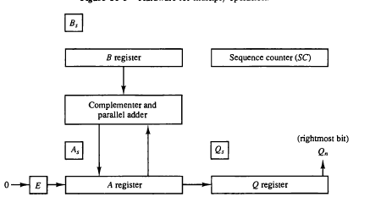
Cont..
The hardware for multiplication consist of the equipment shown in figure.
The multiplier stored in Q register and its sign in Qs.
The sequence counter SC is initially set to a number equal to the number of bits in the multiplier.
  The counter is decremented by 1 after forming each partial product.
  Fig: (Hardware for multiply operation)

Slide 13
Cont..
Initially the multiplicand is in register B and the multiplier in Q.
The sum of A and B forms a partial product which is transferred to the EA register.
  Both the partial product and multiplier are shifted to the right.(shr EAQ)
  Least significant bit of A is shifted into the most significant position of Q,
  The bit from E is shifted into the most significant position of A and 0 to E.
After the shift, one bit of partial product is shifted into Q, pushing the multiplier bit one position to the right.
In this manner, the rightmost flip-flop in register Q, designated by Qn, will hold the bit of the multiplier, which must be inspected next.

Slide 14
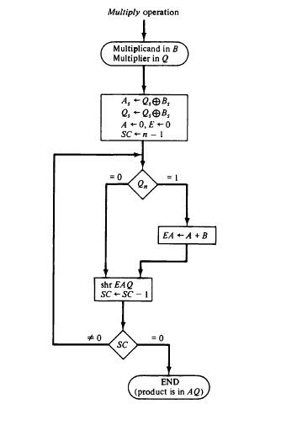
Hardware Algorithm
    jl

Slide 15
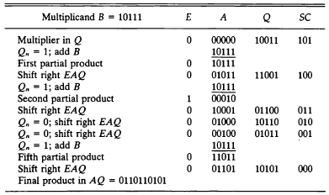
Fig: Numerical Example for binary multiplier

Slide 16
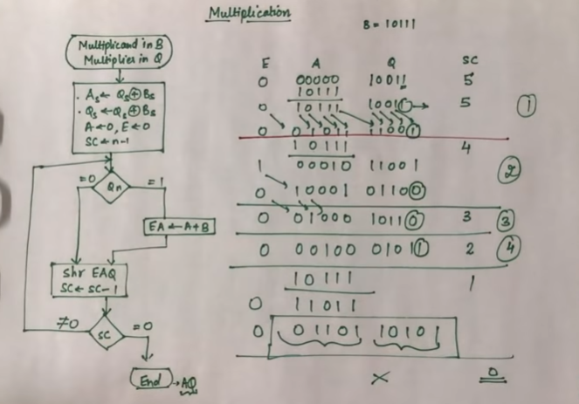
Example of multiplication algorithm

Slide 17
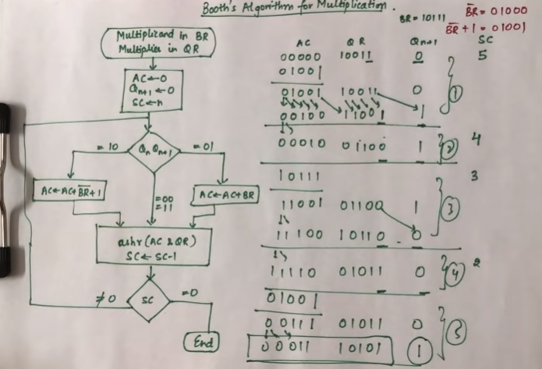
Example of Booth multiplication algorithm

